Slide 1
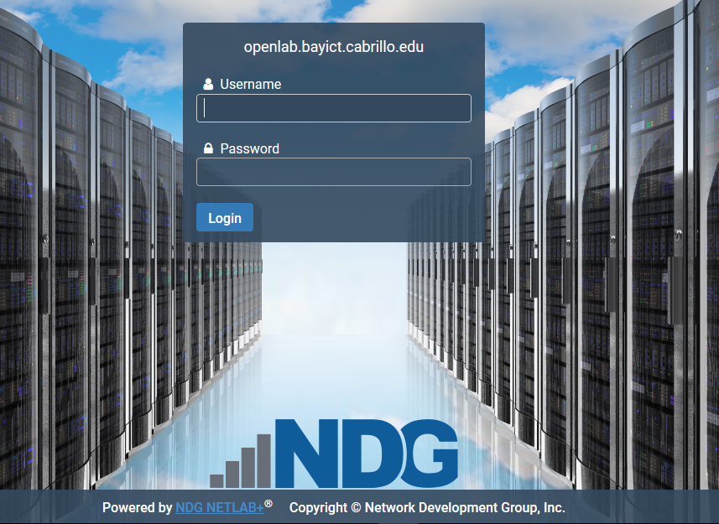
53D NetLab Instructions
Site: https://openlab.bayict.cabrillo.edu
Username = Student ID
Existing NetLab User, Password = currentpassword
New NetLab User Temp Password = lovefhda, Change at First Login

Slide 2
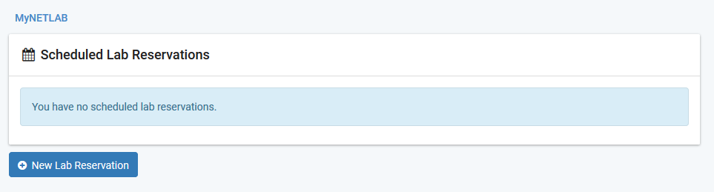
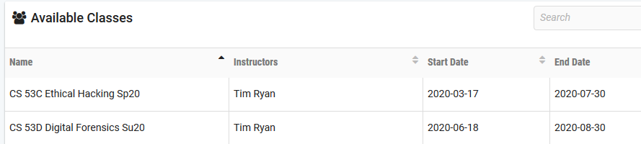
Select New Lab Reservation…Schedule Lab for Myself…
Select Appropriate Class (CS 53D)…

Slide 3
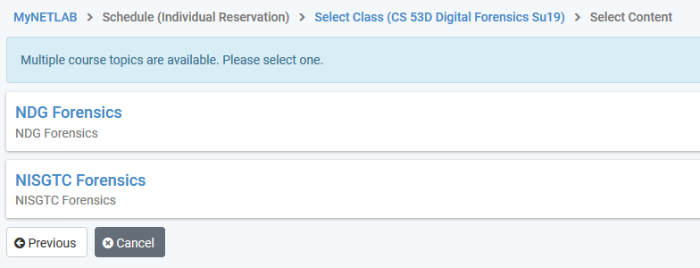
Select Content…
Note: Most Assigned Labs Are In NDG Forensics

Slide 4
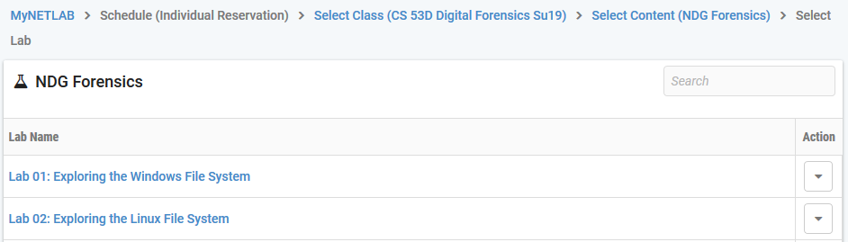
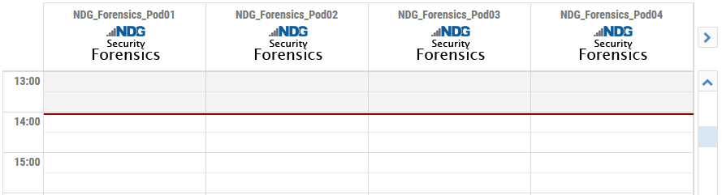
Select Desired Lab…
Select Pod, Scroll Right If Needed, Click Directly Under Current Time…

Slide 5
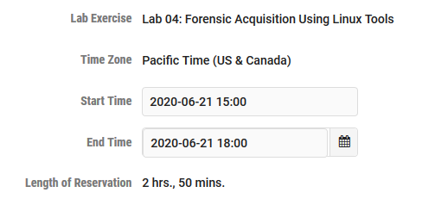
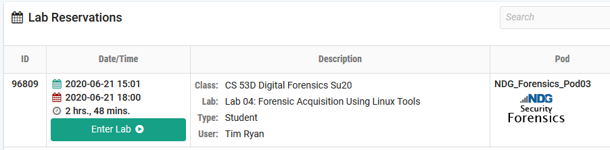
Increase Reservation Time, Min 2 Hours, Max 4 Hours, Submit, OK…
Select Enter Lab…

Slide 6
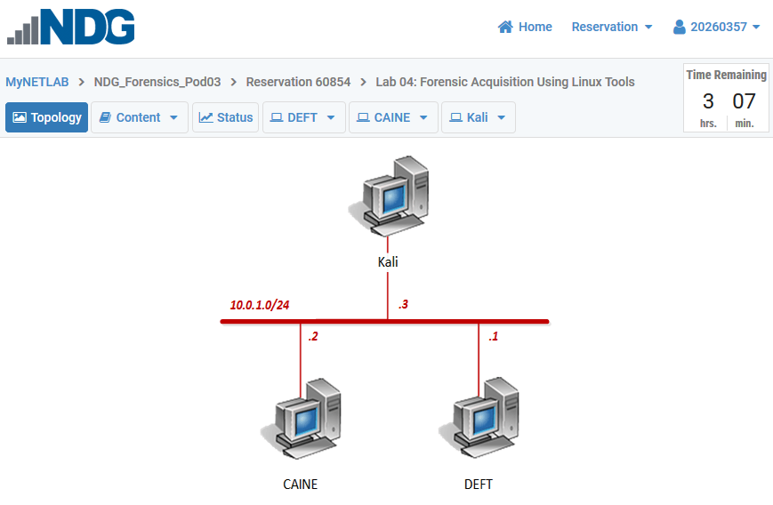
Common Topology for All NDG Labs

Slide 7
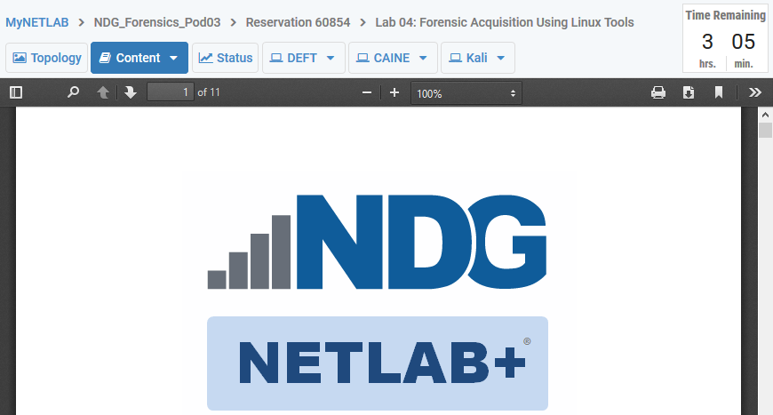
Select Content, Download pdf, also in Files/NetLab Docs

Slide 8
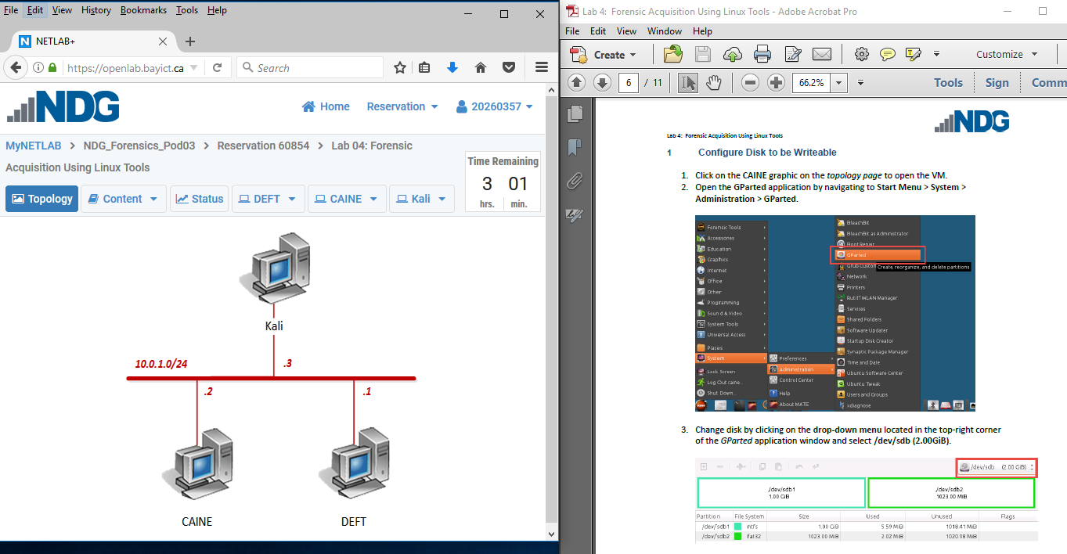
Position Lab Window and Content Doc, Follow Instructions…

Slide 9
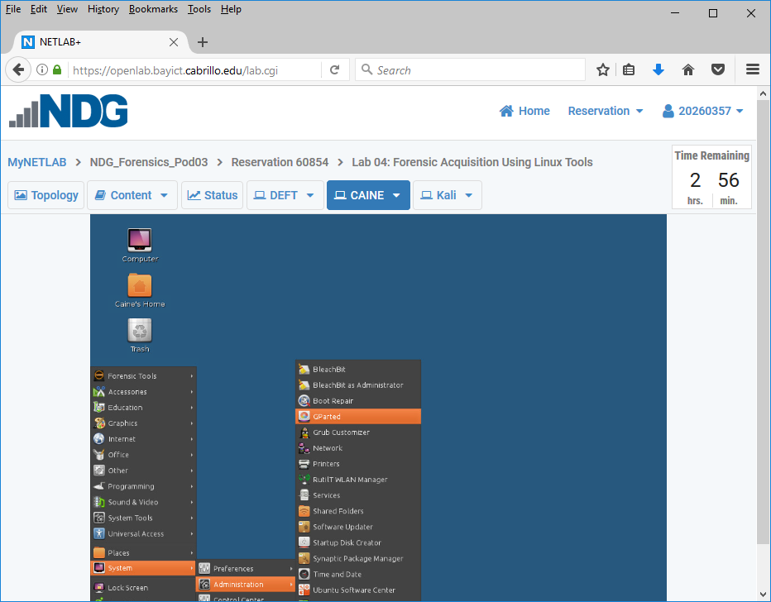
Important: Take 8-10 Screenshots During Lab
Include Login ID (Upper Right) in First Slide
Create ppt, doc or pdf File, Submit in Canvas/Assignments/Lab #4

